Slide 1
Network DEA in Insurance Industry
吳延東

Slide 2
產險、壽險 | Z1 no split | Z1 split
CRS
VRS |  | 時間（5 年）

Slide 3
產險、壽險 | Z1 no split | Z1 split
CRS
VRS |  | 時間（5 年）

Slide 4
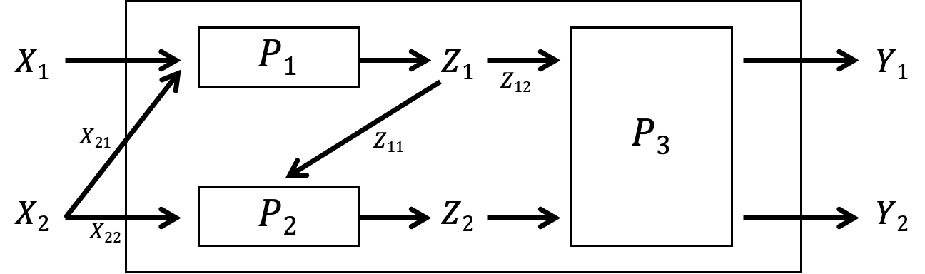
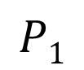
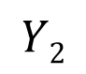
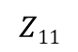
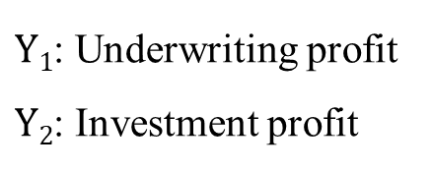
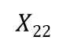
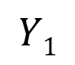
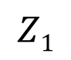
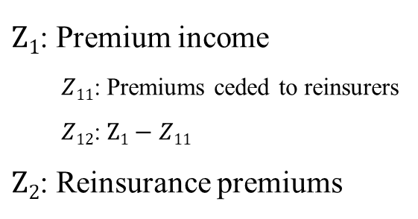
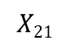
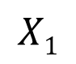
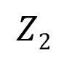
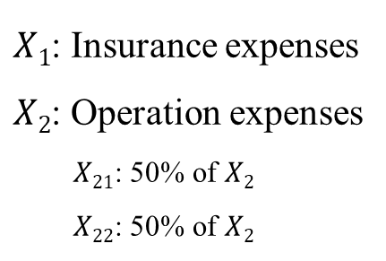
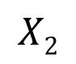
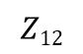
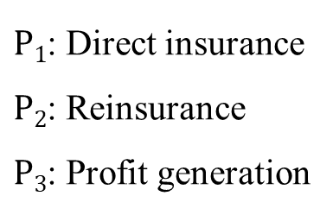
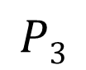
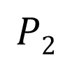
Revised network DEA model
Network DEA in Insurance Industry
(CRS)
Notations:
$X1$: Insurance expenses
$X2$: Operation expenses
$X21$: 50% of $X2$
$X22$: 50% of $X2$
$Z1$: Premium income
$Z11$: Premiums ceded to reinsurers
$Z12$: $Z1−Z11$
$Z2$: Reinsurance premiums
$P1$: Direct insurance
$P2$: Reinsurance
$P3$: Profit generation
$Y1$: Underwriting profit
$Y2$: Investment profit
$$X1$$
$$P1$$
$$Z1$$
$$Y1$$
$$Z12$$
$$X21$$
$$P3$$
$$Z11$$
$$X2$$
$$P2$$
$$Z2$$
$$Y2$$
$$X22$$

Slide 5
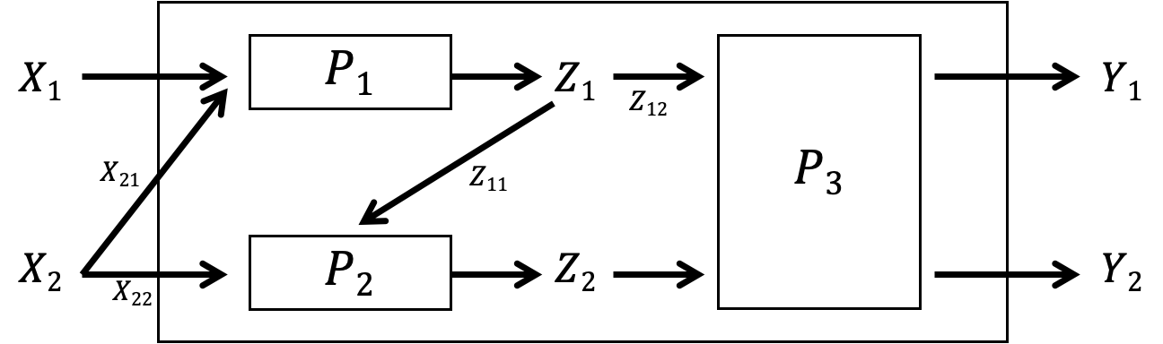
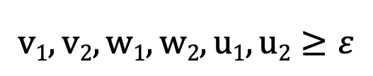
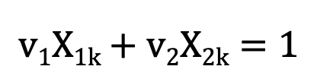
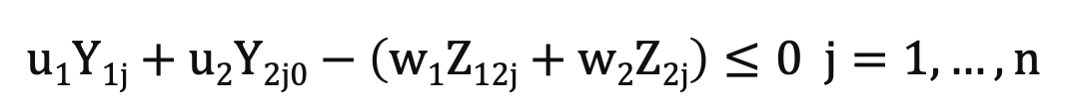
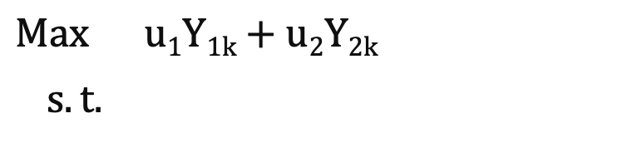
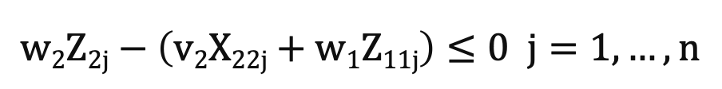
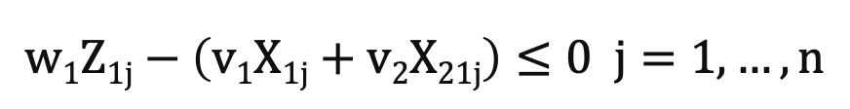
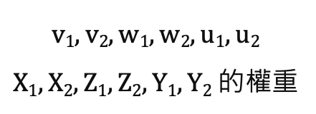
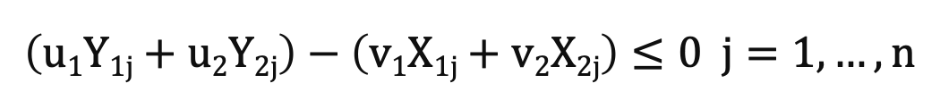
Revised network DEA model
Network DEA in Insurance Industry
(CRS)
$$Max u1Y1k+u2Y2k$$
$s.t.$
$$v1X1k+v2X2k=1$$
$$\left(u1Y1j+u2Y2j\right)−\left(v1X1j+v2X2j\right)≤0 j=1,…,n$$
$$v1, v2, w1, w2, u1, u2$$
$X1, X2, Z1, Z2, Y1, Y2$ 的權重
$$w1Z1j−\left(v1X1j+v2X21j\right)≤0 j=1,…,n$$
$$w2Z2j−\left(v2X22j+w1Z11j\right)≤0 j=1,…,n$$
$$u1Y1j+u2Y2j0−\left(w1Z12j+w2Z2j\right)≤0 j=1,…,n$$
$$v1, v2, w1, w2, u1, u2≥ε$$

Slide 6
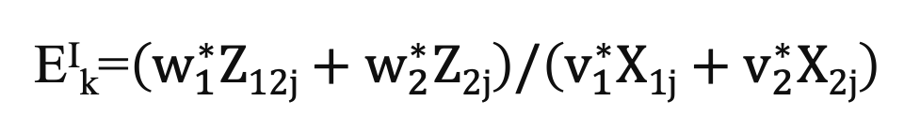
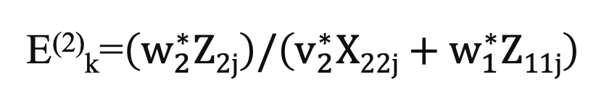
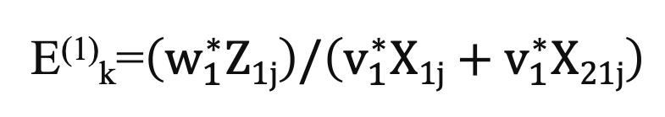
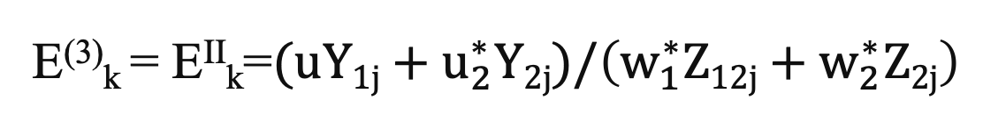
Revised network DEA model
Network DEA in Insurance Industry
(CRS)
E⁽¹⁾_{k}=$\left(w_{1}^{∗}Z1j\right)/\left(v_{1}^{∗}X1j+v_{1}^{∗}X21j\right)$
E⁽²⁾_{k}=$\left(w_{2}^{∗}Z2j\right)/\left(v_{2}^{∗}X22j+w_{1}^{∗}Z11j\right)$
E^{I}_{k}=$\left(w_{1}^{∗}Z12j+w_{2}^{∗}Z2j\right)/\left(v_{1}^{∗}X1j+v_{2}^{∗}X2j\right)$
E⁽³⁾_{k} = E^{II}_{k}=$(uY1j+u_{2}^{∗}Y2j)/\left(w_{1}^{∗}Z12j+w_{2}^{∗}Z2j\right)$

Slide 7
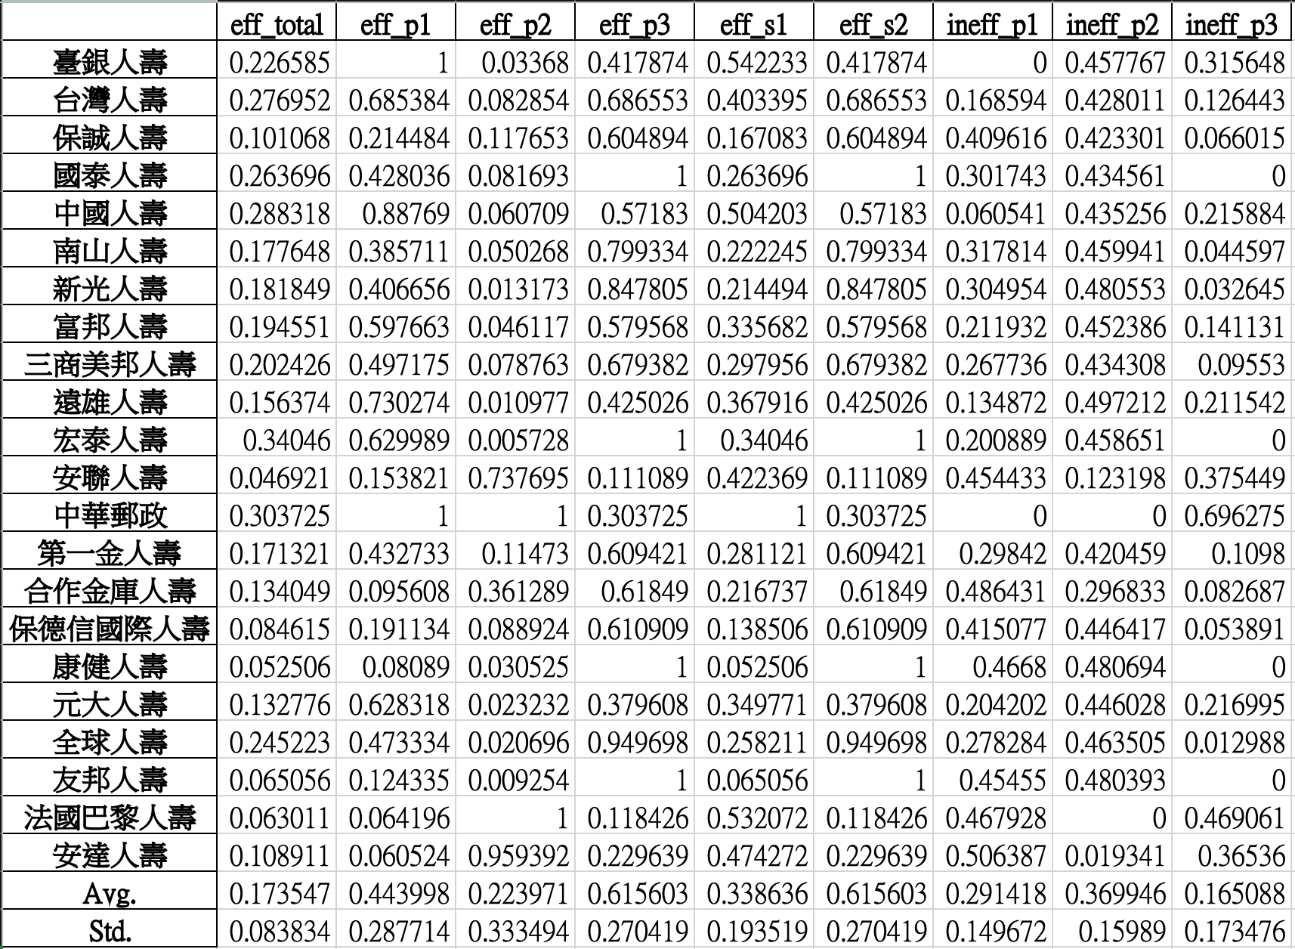
Revised network DEA model
Network DEA in Insurance Industry
(CRS)
2019
壽險
產險

Slide 8
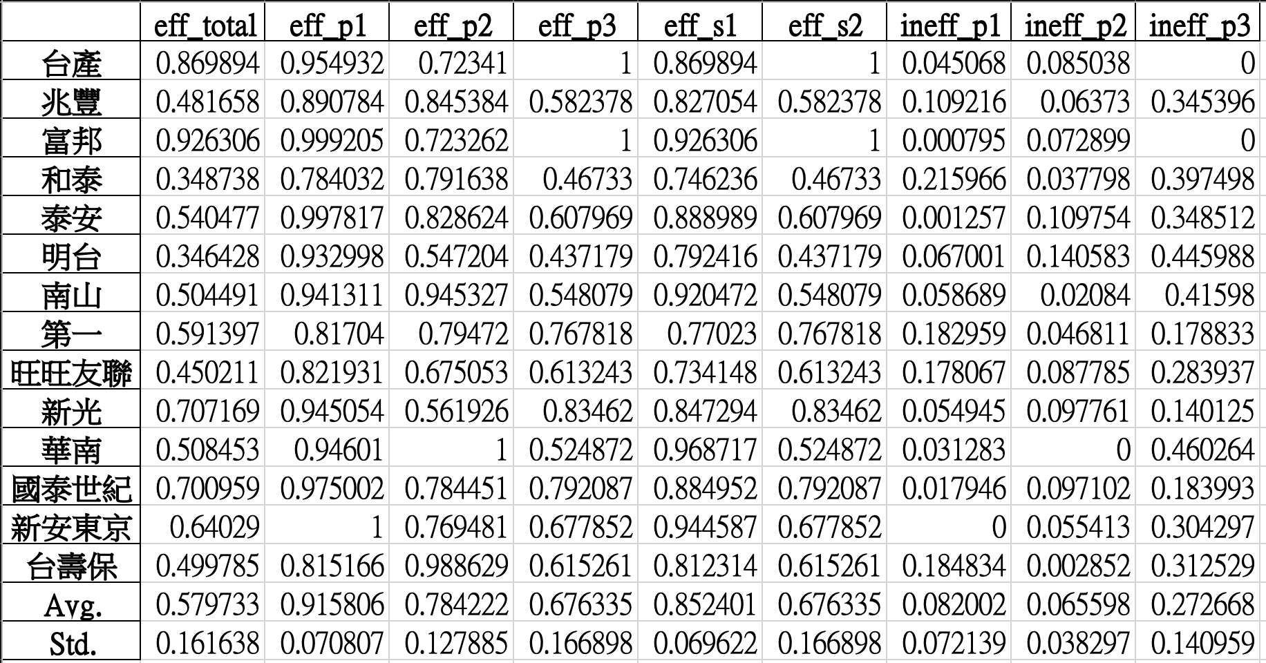
Revised network DEA model
Network DEA in Insurance Industry
(CRS)
2019
壽險
產險

Slide 9
產險、壽險 | Z1 no split | Z1 split
CRS
VRS |  | 時間（5 年）

Slide 10
Revised network DEA model
Network DEA in Insurance Industry
(VRS input-oriented)
Notations:
$X1$: Insurance expenses
$X2$: Operation expenses
$X21$: 50% of $X2$
$X22$: 50% of $X2$
$Z1$: Premium income
$Z11$: Premiums ceded to reinsurers
$Z12$: $Z1−Z11$
$Z2$: Reinsurance premiums
$P1$: Direct insurance
$P2$: Reinsurance
$P3$: Profit generation
$Y1$: Underwriting profit
$Y2$: Investment profit
$$X1$$
$$P1$$
$$Z1$$
$$Y1$$
$$Z12$$
$$X21$$
$$P3$$
$$Z11$$
$$X2$$
$$P2$$
$$Z2$$
$$Y2$$
$$X22$$

Slide 11
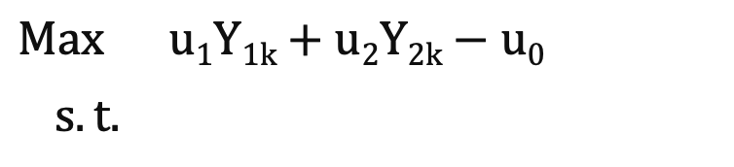
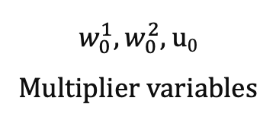
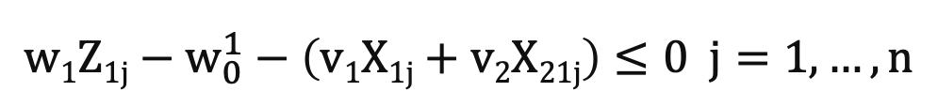
Revised network DEA model
Network DEA in Insurance Industry
(VRS input-oriented)
$$Max u1Y1k+u2Y2k−u0$$
$s.t.$
$$v1X1k+v2X2k=1$$
$$\left(u1Y1j+u2Y2j−u0\right)−\left(v1X1j+v2X2j\right)≤0 j=1,…,n$$
$$v1, v2, w1, w2, u1, u2$$
$X1, X2, Z1, Z2, Y1, Y2$ 的權重
$$w1Z1j−w_{0}^{1}−\left(v1X1j+v2X21j\right)≤0 j=1,…,n$$
$$w2Z2j−w_{0}^{2}−\left(v2X22j+w1Z11j−w_{0}^{1}\right)≤0 j=1,…,n$$
$$w_{0}^{1},w_{0}^{2}, u0$$
Multiplier variables
$$u1Y1j+u2Y2j−u0−\left(w1Z12j+w2Z2j−w_{0}^{1}−w_{0}^{2}\right)≤0 j=1,…,n$$
$$v1, v2, w1, w2, u1, u2≥ε$$

Slide 12
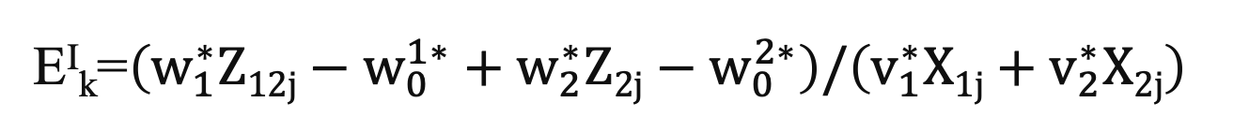
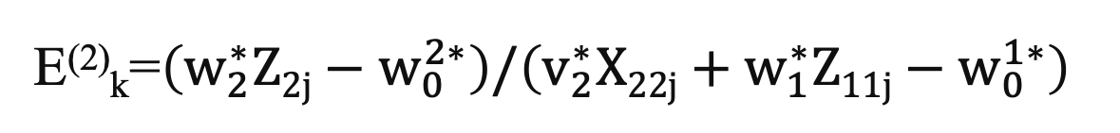
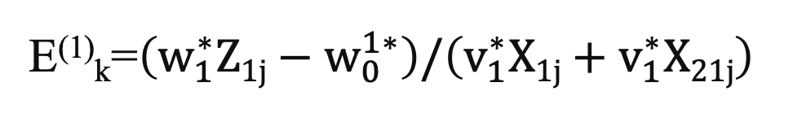
Revised network DEA model
Network DEA in Insurance Industry
(VRS input-oriented)
E⁽¹⁾_{k}=$\left(w_{1}^{∗}Z1j−w_{0}^{1∗}\right)/\left(v_{1}^{∗}X1j+v_{1}^{∗}X21j\right)$
E⁽²⁾_{k}=$\left(w_{2}^{∗}Z2j−w_{0}^{2∗}\right)/\left(v_{2}^{∗}X22j+w_{1}^{∗}Z11j−w_{0}^{1∗}\right)$
E^{I}_{k}=$\left(w_{1}^{∗}Z12j−w_{0}^{1∗}+w_{2}^{∗}Z2j−w_{0}^{2∗}\right)/\left(v_{1}^{∗}X1j+v_{2}^{∗}X2j\right)$
E⁽³⁾_{k} = E^{II}_{k}=$(uY1j+u_{2}^{∗}Y2j−u_{0}^{∗})/\left(w_{1}^{∗}Z12j−w_{0}^{1∗}+w_{2}^{∗}Z2j−w_{0}^{2∗}\right)$

Slide 13
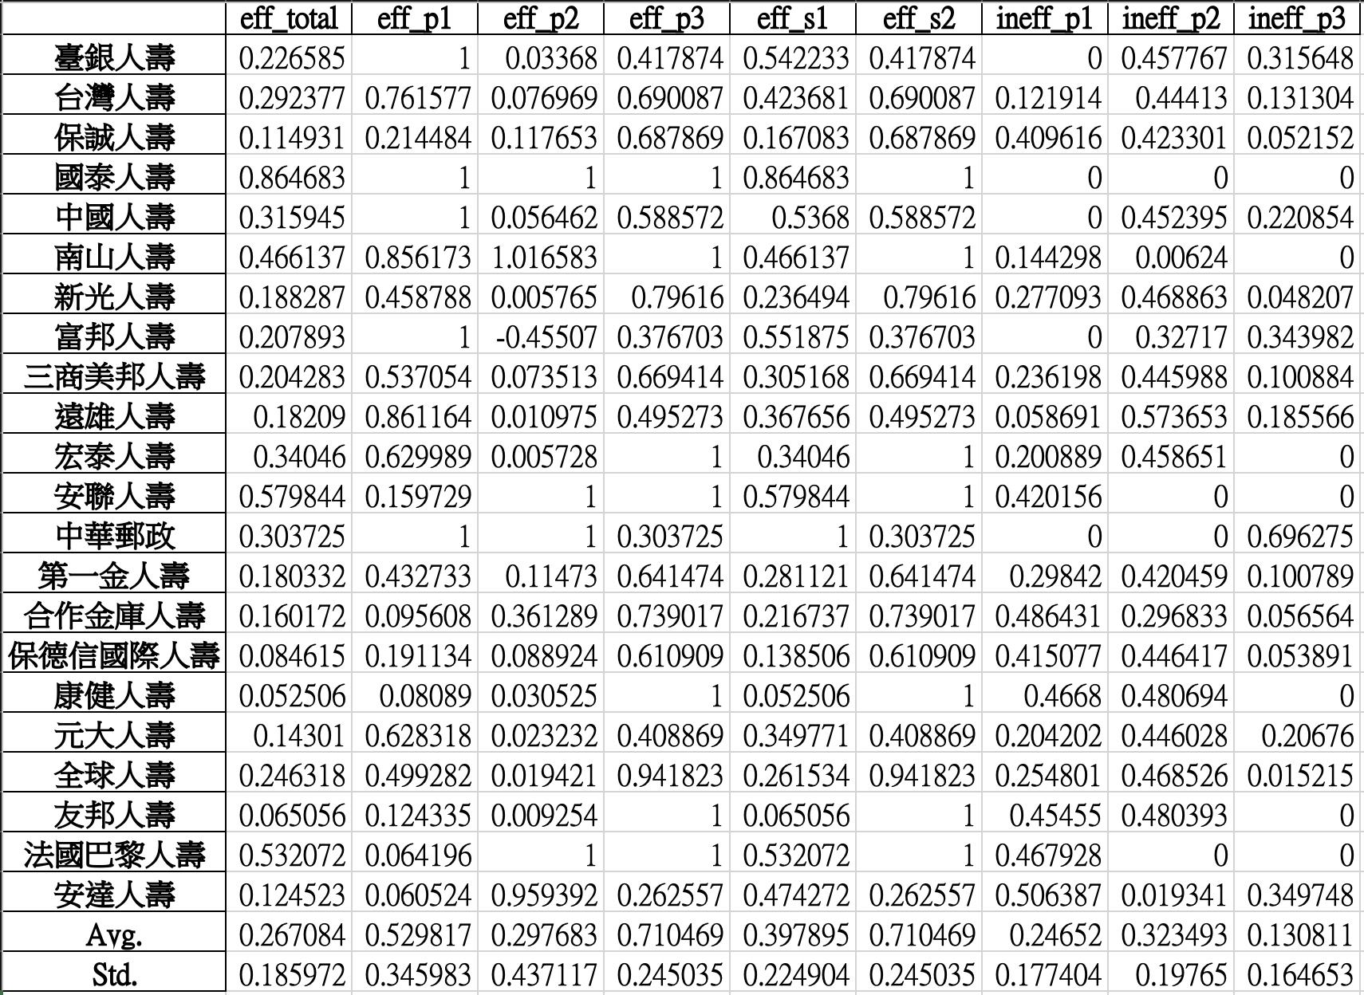
Revised network DEA model
Network DEA in Insurance Industry
(CRS)
2019
壽險
產險

Slide 14
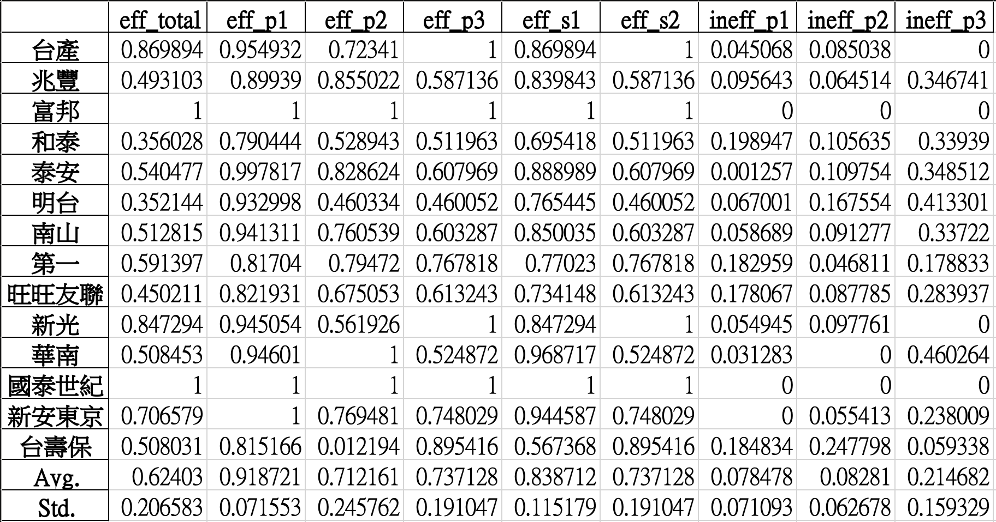
Revised network DEA model
Network DEA in Insurance Industry
(VRS input-oriented)
2019
壽險
產險

Slide 15
產險、壽險 | Z1 no split | Z1 split
CRS
VRS |  | 時間（5 年）

Slide 16
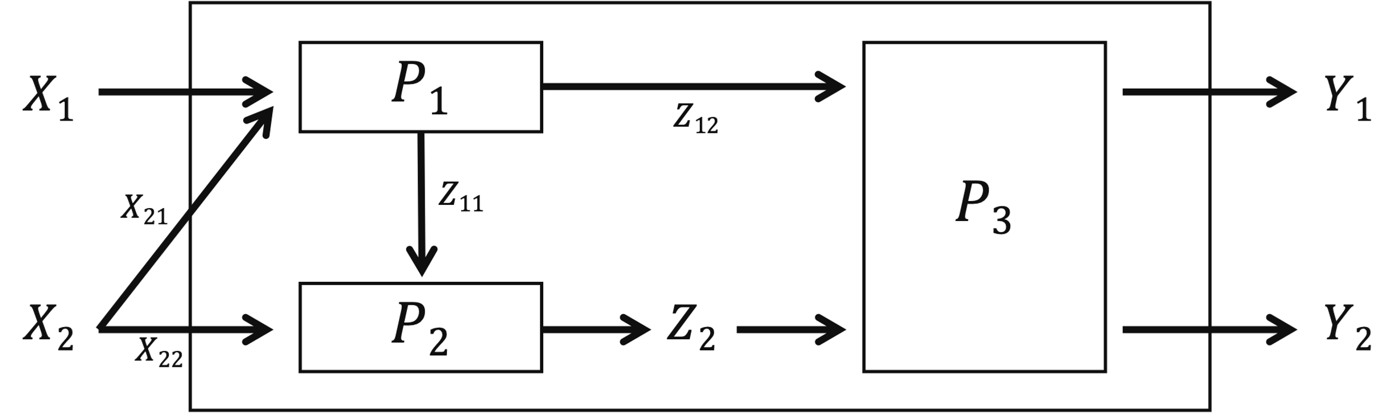
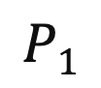
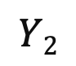
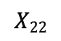
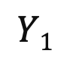
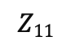
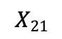
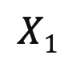
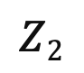




Revised network DEA model
Network DEA in Insurance Industry
(Z1_split CRS)
Notations:
$X1$: Insurance expenses
$X2$: Operation expenses
$X21$: 50% of $X2$
$X22$: 50% of $X2$
$Z1$: Premium income
$Z11$: Premiums ceded to reinsurers
$Z12$: $Z1−Z11$
$Z2$: Reinsurance premiums
$P1$: Direct insurance
$P2$: Reinsurance
$P3$: Profit generation
$Y1$: Underwriting profit
$Y2$: Investment profit
$$X1$$
$$P1$$
$$Y1$$
$$Z12$$
$$X21$$
$$Z11$$
$$P3$$
$$X2$$
$$P2$$
$$Z2$$
$$Y2$$
$$X22$$

Slide 17





Revised network DEA model
Network DEA in Insurance Industry
(Z1_split CRS)
$$v1, v2, w11, w12, w2,u1, u2$$
$X1, X2, Z1, Z2, Y1, Y2$ 的權重
$$Max u1Y1k+u2Y2k$$
$s.t.$
$$v1X1k+v2X2k=1$$
$$\left(u1Y1j+u2Y2j\right)−\left(v1X1j+v2X2j\right)≤0 j=1,…,n$$
$$\left(w11Z11j+w12Z12j\right)−\left(v1X1j+v2X21j\right)≤0 j=1,…,n$$
$$w2Z2j−\left(v2X22j+w11Z11j\right)≤0 j=1,…,n$$
$$\left(u1Y1j+u2Y2j\right)−\left(w12Z12j+w2Z2j\right)≤0 j=1,…,n$$
$$v1, v2, w1, w2, u1, u2≥ε$$

Slide 18




Revised network DEA model
Network DEA in Insurance Industry
(Z1_split CRS)
E⁽¹⁾_{k}=$\left(w_{11}^{∗}Z11j+w_{12}^{∗}Z12j\right)/\left(v_{1}^{∗}X1j+v_{2}^{∗}X21j\right)$
E⁽²⁾_{k}=$\left(w_{2}^{∗}Z2j\right)/\left(v_{2}^{∗}X22j+w_{11}^{∗}Z11j\right)$
E^{I}_{k}=$\left(w_{12}^{∗}Z12j+w_{2}^{∗}Z2j\right)/\left(v_{1}^{∗}X1j+v_{2}^{∗}X2j\right)$
E⁽³⁾_{k} = E^{II}_{k}=$(u_{1}^{∗}Y1j+u_{2}^{∗}Y2j)/\left(w_{12}^{∗}Z12j+w_{2}^{∗}Z2j\right)$

Slide 19

Revised network DEA model
Network DEA in Insurance Industry
(CRS)
2019
壽險
產險

Slide 20

Revised network DEA model
Network DEA in Insurance Industry
(Z1_split CRS)
2019
壽險
產險

Slide 21
產險、壽險 | Z1 no split | Z1 split
CRS
VRS |  | 時間（5 年）

Slide 22
Revised network DEA model
Network DEA in Insurance Industry
(Z1_split VRS input-oriented)
Notations:
$X1$: Insurance expenses
$X2$: Operation expenses
$X21$: 50% of $X2$
$X22$: 50% of $X2$
$Z1$: Premium income
$Z11$: Premiums ceded to reinsurers
$Z12$: $Z1−Z11$
$Z2$: Reinsurance premiums
$P1$: Direct insurance
$P2$: Reinsurance
$P3$: Profit generation
$Y1$: Underwriting profit
$Y2$: Investment profit
$$X1$$
$$P1$$
$$Y1$$
$$Z12$$
$$X21$$
$$Z11$$
$$P3$$
$$X2$$
$$P2$$
$$Z2$$
$$Y2$$
$$X22$$

Slide 23



Revised network DEA model
Network DEA in Insurance Industry
(Z1_split VRS input-oriented)
$$Max u1Y1k+u2Y2k−u0$$
$s.t.$
$$v1X1k+v2X2k=1$$
$$\left(u1Y1j+u2Y2j−u0\right)−\left(v1X1j+v2X2j\right)≤0 j=1,…,n$$
$$v1, v2, w11, w12, w2,u1, u2$$
$X1, X2, Z1, Z2, Y1, Y2$ 的權重
$$\left(w11Z11j+w12Z12j−w_{0}^{1}\right)−\left(v1X1j+v2X21j\right)≤0 j=1,…,n$$
$$w2Z2j−w_{0}^{2}−\left(v2X22j+w11Z11j−w_{0}^{1}\right)≤0 j=1,…,n$$
$$w_{0}^{1},w_{0}^{2}, u0$$
Multiplier variables
$$\left(u1Y1j+u2Y2j−u0\right)−\left(w12Z12j−w_{0}^{1}+w2Z2j−w_{0}^{2}\right)≤0 j=1,…,n$$
$$v1, v2, w1, w2, u1, u2≥ε$$

Slide 24



Revised network DEA model
Network DEA in Insurance Industry
(Z1_split VRS input-oriented)
E⁽¹⁾_{k}=$\left(w_{11}^{∗}Z11j+w_{12}^{∗}Z12j−w_{0}^{1∗}\right)/\left(v_{1}^{∗}X1j+v_{2}^{∗}X21j\right)$
E⁽²⁾_{k}=$\left(w_{2}^{∗}Z2j−w_{0}^{2∗}\right)/\left(v_{2}^{∗}X22j+w_{11}^{∗}Z11j−w_{0}^{1∗}\right)$
E^{I}_{k}=$\left(w_{12}^{∗}Z12j−w_{0}^{1∗}+w_{2}^{∗}Z2j−w_{0}^{2∗}\right)/\left(v_{1}^{∗}X1j+v_{2}^{∗}X2j\right)$
E⁽³⁾_{k} = E^{II}_{k}=$(u_{1}^{∗}Y1j+u_{2}^{∗}Y2j−u_{0}^{∗})/\left(w_{12}^{∗}Z12j−w_{0}^{1∗}+w_{2}^{∗}Z2j−w_{0}^{2∗}\right)$

Slide 25

Revised network DEA model
Network DEA in Insurance Industry
(CRS)
2019
壽險
產險

Slide 26

Revised network DEA model
Network DEA in Insurance Industry
(Z1_split VRS input-oriented)
2019
壽險
產險

Slide 27

Network DEA in Insurance Industry
保險業務會影響再保分保業務
理賠與投資同時進行

